Slide 1

SUBJECT : PYTHON PROGRAMMING
SUBJECT CODE : BCSG0001
Dr. Manoj Varshney
Asst. Professor
T&D Dept.
GLA University,
Mathura

Slide 2
Module-1
Introduction to Python : Introduction and Basics , Setting up the path , Python Data Variables & Operators , id() and type() functions , coding standards
Control Structures : if-else , elif , Nested-if, Iteration, Control structures , break, continue, pass
String Manipulation : Accessing , Strings , Basic operations , string slicing , Functions and methods
Lists : Introduction ,Accessing List ,Operations , Working with Lists, Functions and methods
Tuple : Introduction , Accessing Tuple , Operations , Working with Tuples , Functions and methods

Slide 3
IDEs for Python
IDLE
PyCharm
Spyder
Sublime Text
Visual Studio Code
Atom
Jupyter
PyDev
Thonny
Wing
Active Python
Google Colab ( Online Platform) etc.

Slide 4
Programming Languages
Here is the list of programming languages:-
FORTRAN
Python
Java
C/C++
Ada
Simula
C#
Ruby
Objective – C etc.

Slide 5


Slide 6
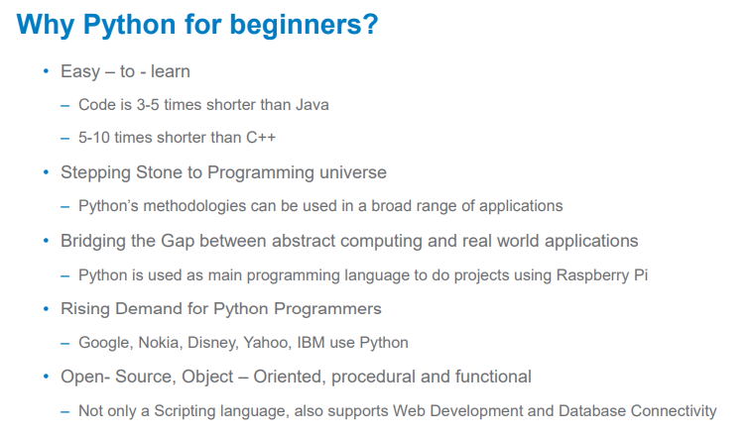

Slide 7
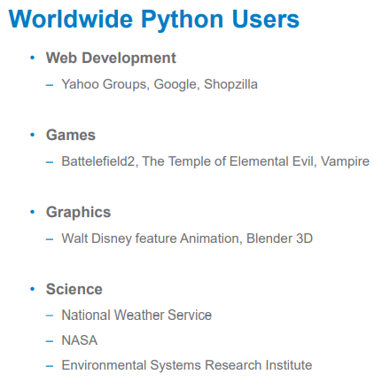

Slide 8

Evolution of Python
Guido Van Rossum developed Python in early 1990s at National Research Institute for Mathematics and Computer Science, Netherlands.
Named after a circus show Monty Python show.
Derives its features from many languages like Java , C++ , ABC , C , Modula-3 , Smalltalk , Algol-68 , Unix Shell and other scripting languages.

Slide 9
Features of Python
Python is a High-Level, Interpreted.
Extensive Standard Library
Portable
Support for GUI
Automatic Garbage Collection

Slide 10
Objective of Program
INPUT
PROCESS
OUTPUT

Slide 11
Examples
Write a Python Program to take two numbers from user, find their addition and display to the user.
Write a Python Program to take temperature in celcius, convert into Fahrenheit and then display it.
Write a Program to find the x^{y} where x and y are taken from user.
Write a Program to input your name and display that name.

Slide 12
Variables
It is an entity which holds some value in our program.
It can change during program execution
No declaration of variables
Datatype of a variable can change during program execution.
Example, a=5
b=6.1
c=“Piyush”
x=5+3J

Slide 13
Rules for Python Variables
A variable name must start with a letter or the underscore character.
A variable name cannot start with a number.
A variable name can only contain alpha-numeric characters and underscores (a-z, A-Z, 0-9, and _ )
Variable names are case-sensitive (age, Age and AGE are three different variables)
Variable name should not contain Whitespaces like reg no
Variable name should not be keyword (if, else etc)

Slide 14
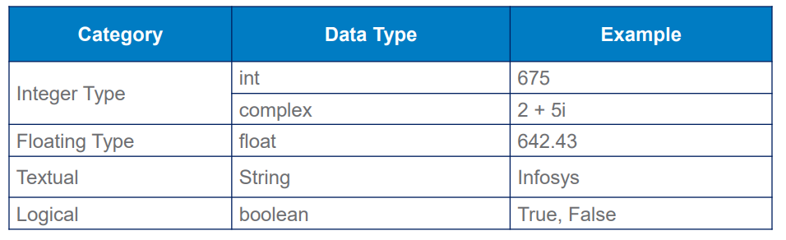
Different types of Data

Slide 15
Lets start the coding
print(“Piyush”)
a=5
print(a)
a=5
b=2
c=a+b
print(c)
a=input()
print(a)

Slide 16
print()
Purpose: To print anything on the output screen
print(“I am Piyush Vashistha”)
s=“I am Piyush Vashistha”
print(s)
print(“Hello”)
print(“Bye”)
print(“Hello”, ”Bye”, ”GLA”, ”Piyush”)
print(“Hello”, ”Bye”, ”GLA”, ”Piyush”, end=“*”)
print(“Stay Safe”)
print(“Hello”, ”Bye”, ”GLA”, ”Piyush”, sep=“*”)

Slide 17
input()
Purpose: To take input from user.By default, it will take input in the form of string.
A=input()
X=input(“Enter the age of the student”)
P=int(input())
R=float(input())

Slide 18
Assignment-1
WAP to input two numbers from user and then perform addition, subtraction, division, multiplication and then print the outputs.
WAP to input your name and then display the string as
For example,
I/P : Piyush
O/P : Hello Piyush, Welcome to the world of programming
WAP to take temperature in celcius, convert into Fahrenheit and print it.
WAP to take distance in Kilometeres, convert into metres and then print it.
WAP to input length and breadth of rectangle, find the area and then print it.
WAP to input radius and height of cylinder, find the volume and then print it.
WAP to enter the number of overs in a cricket match(eg. 50 Overs in ODI) and then find the maximum run that can be scored by a single player.

Slide 19
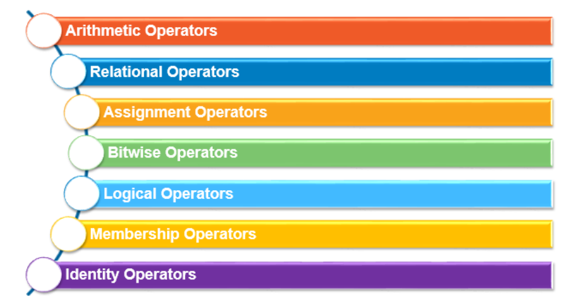
Operators

Slide 20
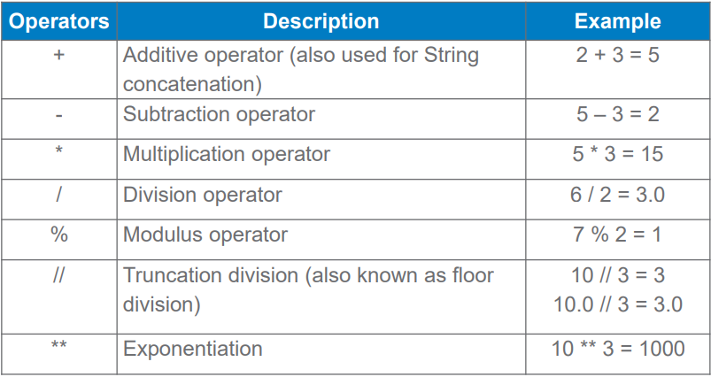
1. Arithmetic Operators

Slide 21
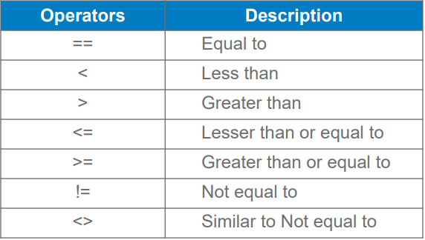
2. Relational Operators

Slide 22
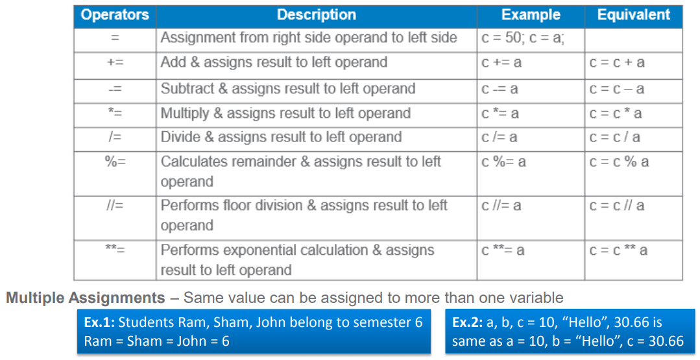
3. Assignment operators

Slide 23
Assignment-2
Q1.Suppose there are 3 buckets a, b and c. First bucket contains 5 Liters water and Second bucket b contains 3 Liters Milk and last bucket c is empty. Your task is to swap the 3 Liters milk from bucket b to bucket a and vice versa using third bucket. Do not write program for that, just solve on your notebook and write the appropriate assignments like b=a etc. Your next question Q2. is based on that.
Q2. WAP to enter two numbers from user and swap the values using third variable
Expected I/P: Enter value of a is 5
Enter value of b is 3
Expected Output: Value of a is 3
Value of b is 5
Q3.WAP to enter the age of person and then print True if he/she is eligible to vote otherwise print False. Use relational operator and do not use if-else statement.
Q4. WAP to enter two points P(x1,y1) and Q(x2,y2) from user and then calculate the distance between these two points. Print the distance using Distance formula
Expected I/P: Enter x1 : 8
Enter y1 : 5
Enter x2 : 5
Enter y2 : 1
Expected Output: Distance between these points is 5

Slide 24
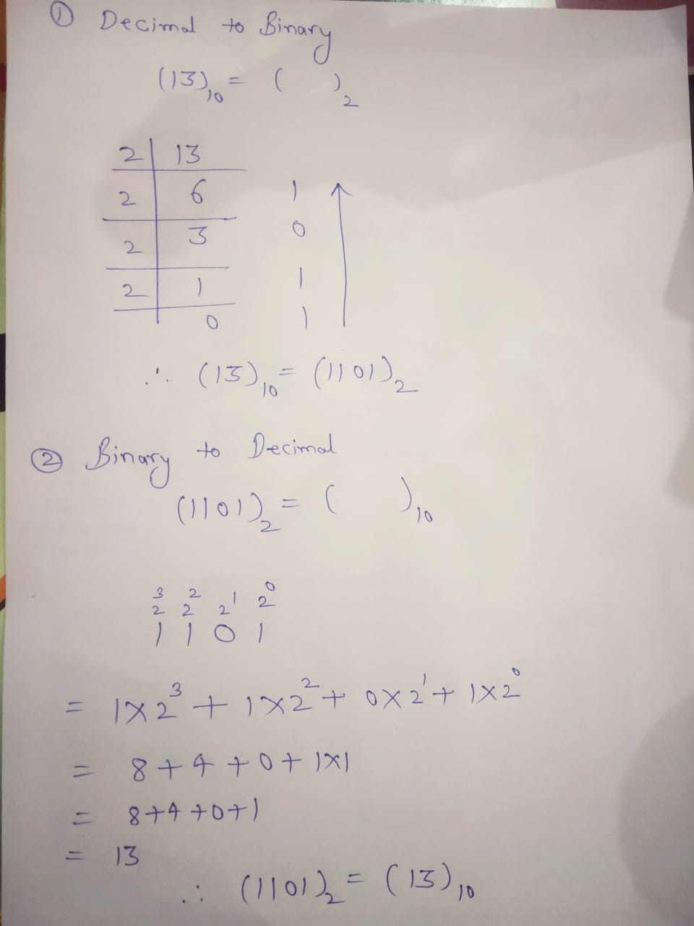
Conversion from Decimal to Binary and Binary to Decimal

Slide 25
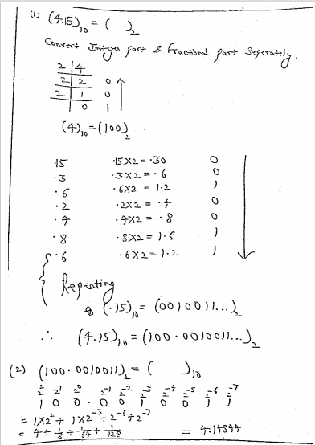

Slide 26
Convert the following
(13)₁₀=()₂
(8)₁₀=()₂
(25)₁₀=()₂
(1000)₂=()₁₀
(1101110)₂=()₁₀
(13.5)₁₀=()₂
(45.2)₁₀=()₂
(11110.1010)₂=()₁₀
(1000.1101)₂=()₁₀
(11111111)₂=()₁₀

Slide 27
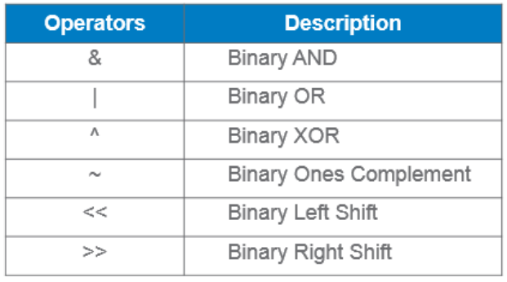
4. Bitwise Operator

Slide 28
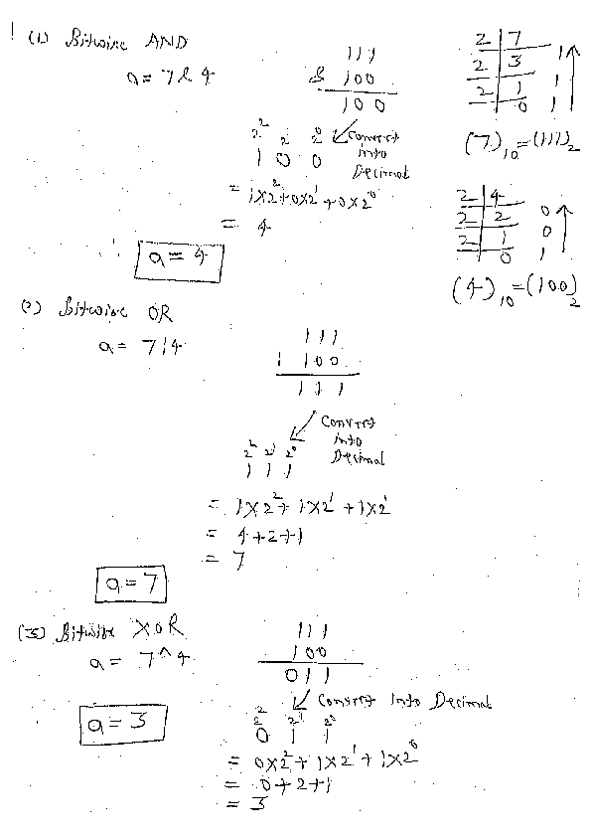

Slide 29
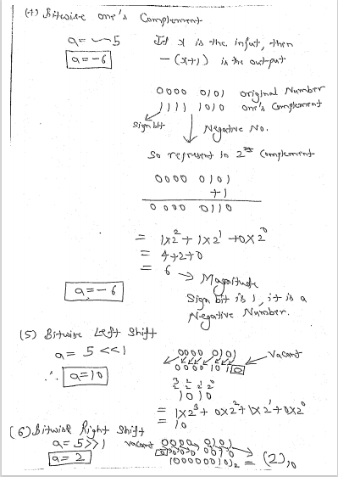

Slide 30
6
110 Binary
00000110 Binary but in 8 bits
-6
Firstly represent 6 in binary i.e.00000110
Write in Sign 2’s complement 11111001
+1
11111010
x=~(-6)
print(x) 00000101

Slide 31
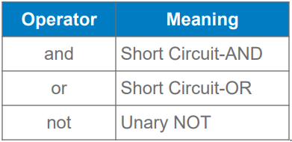
5.Logical operator

Slide 32
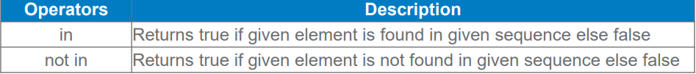
6. Membership Operators

Slide 33
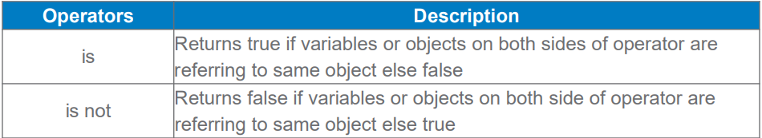
7. Identity Operators

Slide 34
Keywords
These are reserved words having special meaning or fixed meaning.
We cann’t use keyword as a variable name, function name or any other identifier name.
These are case-sensitive.
>>> help()
help>keywords

Slide 35
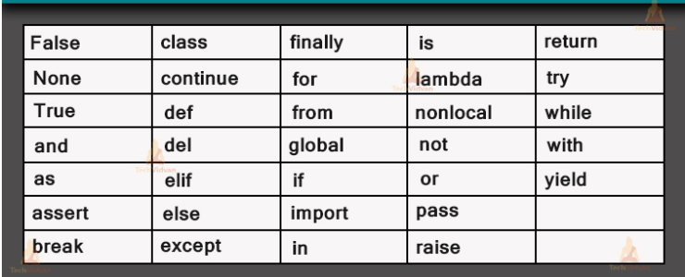

Slide 36
Control Structures or Control Statements

Slide 37
if
if-else
if-elif-else
Nested if

Slide 38
(1) if statement
Syntax:
Use Indentation for blocks instead of curly braces{}
Example: if age>=18:
print(“Eligible to Vote”)
if condition:
Statement(s)

Slide 39
(2) if-else statement
Syntax:
Example:
if age>=18:
print(“Eligible to Vote”)
else:
print(“Not Eligible to Vote”)
if condition:
Statement(s)
else:
Statement(s)

Slide 40
(3) if-elif-else statement
Syntax:
Example: if a>5:
print(“a is greater”)
elif a<5:
print(“a is smaller”)
else:
print(“a is equal to 5”)
if condition:
Statement(s)
elif condition:
Statement(s)
else:
Statement(s)

Slide 41
(4) Nested if statement
Syntax:
Example: if a>b:
if a>c:
print(“a is larger”)
if condition:
if condition:
Statement(s)

Slide 42
Programs
WAP to enter two numbers from user and then print the largest number.
WAP to enter three numbers from user and then print the largest number(a) using Logical operator(b) using Nested if.
WAP to enter a year from the user and then check whether the year is leap year or not.
WAP to enter the age of a person and check whether he/she is eligible to vote or not.
WAP to enter a number from user and check whether it is even or odd.
WAP to enter the marks of three subjects and calculate the percentage and print the following on the basis of percentage.
Percentage | Message
>90 | Excellent
80-89 | Good
70-79 | Average

Slide 43
WAP to enter a number from user and check whether it is divisible by 6 or not.
WAP to enter a number from user and check
(a) If the number is divisible by 3, then print “Tic”
(b) If the number is divisible by 5, then print “Tac”
(c) If the number is divisible by both 3 and 5, then print “Toe”
Suppose you want to purchase two products from Flipkart on Big Billion Days. If the price of any product is upto 499, then you have to pay Rs.40 as delivery charges also, otherwise delivery is free. Calculate and print the total amount which a customer has to pay. Consider delivery charges per product.
Input: Enter price of first product:100
Enter price of second product: 550
Output: Total amount is 690

Slide 44
Loop Statement
It allows repeated execution of a statement or a set of statements multiple times based on the specified condition or range.
Two types of loops:-
1. while loop
2. for loop

Slide 45
While
1.
2.
while condition:
statement(s)
Initialization
while condition:
statement(s)
updation

Slide 46
for loop
Collection can be:-
range()
String
List
Tuple
Set
Dictionary
for variable in collection:
statement(s)

Slide 47
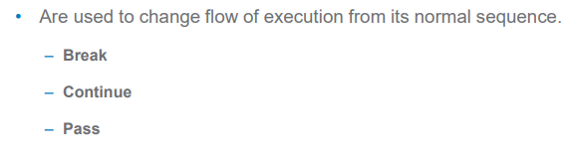
Loop Control Statement

